Slide 1
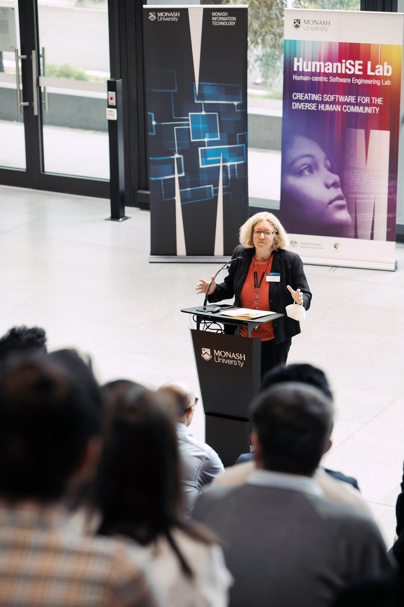




HumaniSE Lab
Breaking the digital divide by creating useful and inclusive software solutions
Web: https://www.monash.edu/it/humanise-lab
Email: humanise-enquiries@monash.edu
Notes:
https://docs.google.com/presentation/d/1lBwRBNzb9a7X2dEYvNZc_BmctXEmZs49gj3aGAUeFJc/edit#slide=id.g71f550c98d_0_71

Slide 2
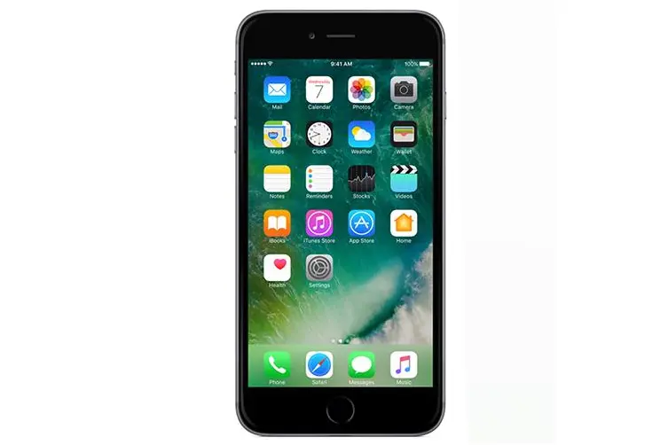
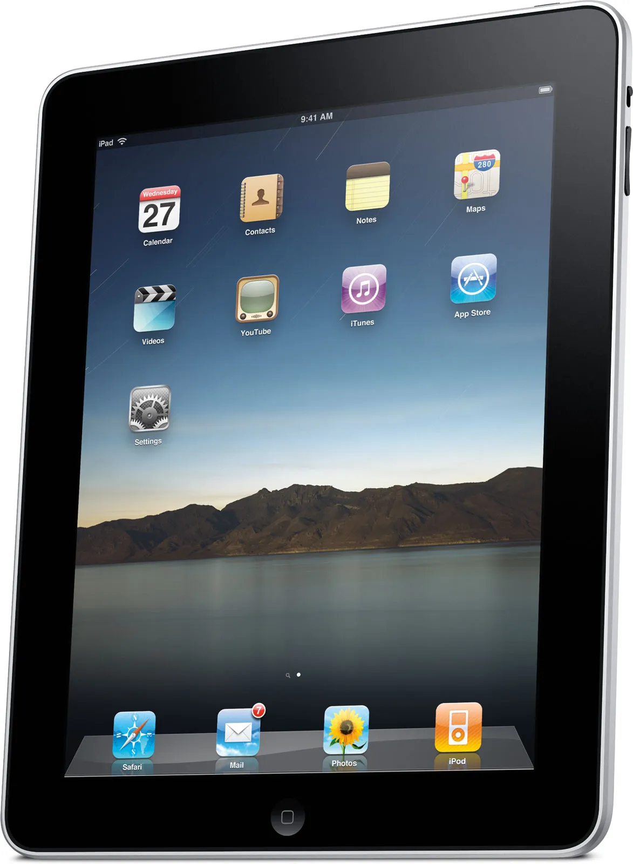
Today’s topic
Software accessibility
or
How easy is it for senior Australians to use mobile applications (apps)?
Notes:
We’ll use the technique of a semi-structured group interview
Small set of prepared questions
Spontaneous follow-up questions

Slide 3
Agenda
Preparation 10-15 min
Explanatory statement & consent forms
Collection of demographic data
Q&A ca 45 min
Topic-related questions
Wrap up
Voucher distribution
Thank you & Farewell

Slide 4

None of the following questions are compulsory!
Don’t answer questions you are not comfortable with.

Slide 5
Preparation
Please read the explanatory statement and sign the consent form
Please fill in your answers in the demographic data paper form
Paper forms will be handed out

Slide 6

Collection of paper forms

Slide 7

Audio recording starts
http://clipart-library.com/

Slide 8
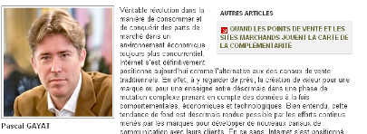
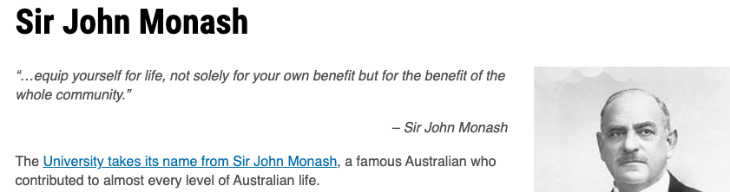
1. Reading on mobile devices
Text size, colour, spacing, contrast, etc…
Notes:
What works
What does NOT work
What workarounds do you use to solve problems
What do you prefer instead

Slide 9
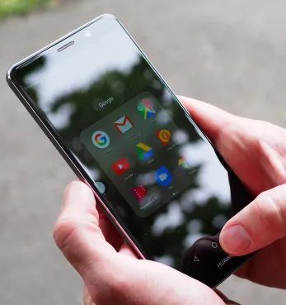
2. Reading in different environments
At home / indoors
Traveling on a bus/train/car
Outside in summer when the sun is bright
etc…
Notes:
Problems with sun glare?
Problems with darkness, shading?
What workarounds do you use to solve problems
What do you prefer instead

Slide 10
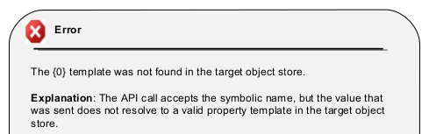
3. Understanding
Technical jargon
Language skills (native vs non-native English speakers)
Cultural differences, e.g. meanings of colors, words, metaphors…
Notes:
What works
What does NOT work
What workarounds do you use to solve problems
What do you prefer

Slide 11
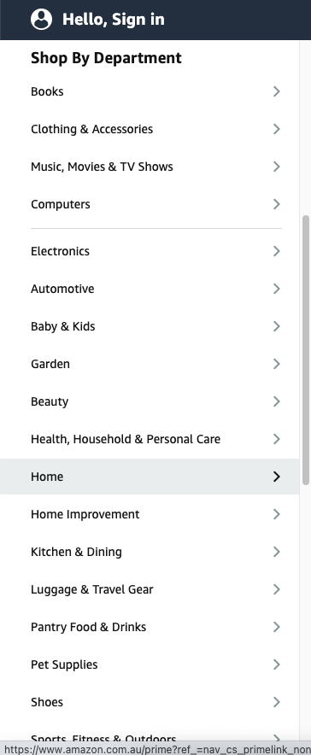
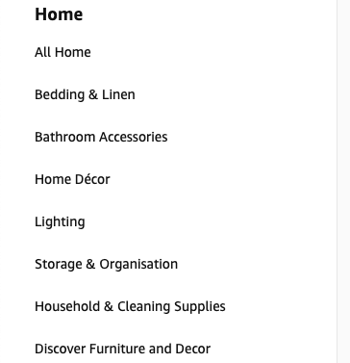
4. Navigation with menus
Menu complexity
If you get lost, what do you do?
Do you memorize the navigation flow?
Notes:
What works
What does NOT work
What workarounds do you use to solve problems
What do you prefer instead

Slide 12
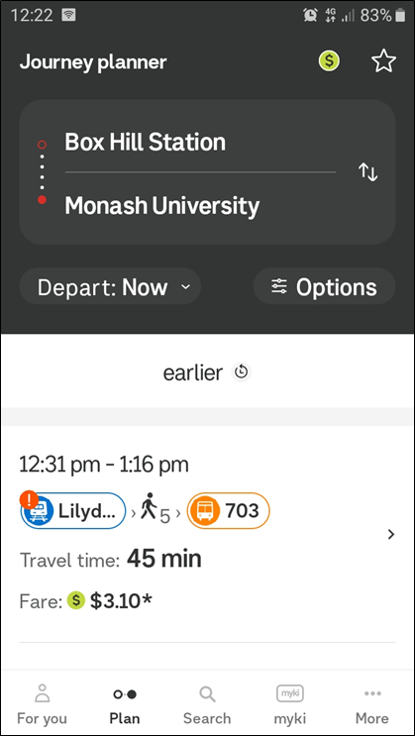
5. Other navigational elements
How intuitive is it for you to navigate within an app?
Visibility of navigational elements
What tell tails are helpful?
What would you find intuitive?
Notes:
What works
What does NOT work
What workarounds do you use to solve problems
What do you prefer instead
Complexity of screen layout
Is the structure clear?

Slide 13
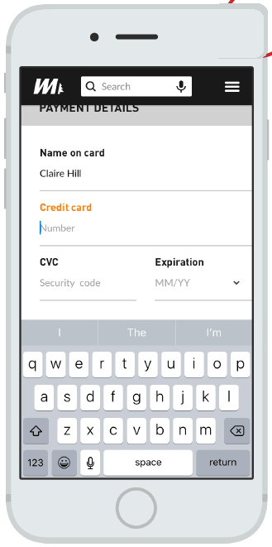
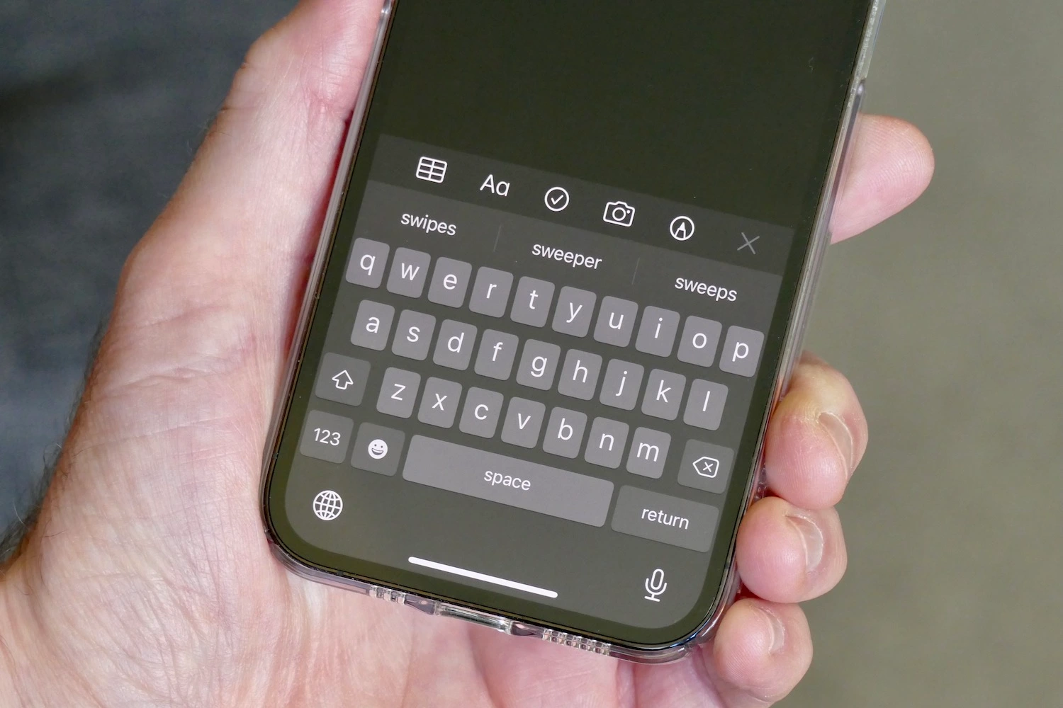
6. Virtual keyboard use
Keyboard layout and size
Keys & labels
Touch feedback
Can you see on the screen where you are writing?
Notes:
What works
What does NOT work
What workarounds do you use to solve problems
What do you prefer instead
Alternative approach
Do you use virtual keyboards on your phone? If yes what for? If not, why not?
If you only had your mobile phone, how would you prefer to enter data so that it is easy and you to like to use it?

Slide 14

7. Touchscreen / trackpad use
Ease of use
Do you know available gestures for a specific task?
Swipe, pinch, tap, etc
Touch feedback
Ease of memorisation
Notes:
What works
What does NOT work
What workarounds do you use to solve problems
What do you prefer instead
Hints & recommendations

Slide 15
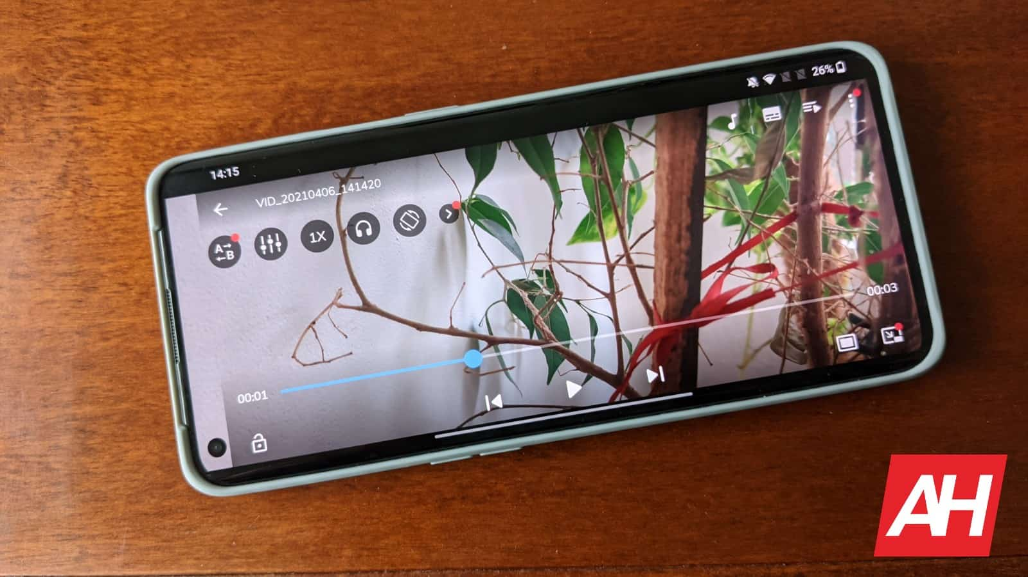
8. Multimedia consumption (audio and video)
Understandability of icons
Ease of use
Pause, stop, rewind
Volume control
Screen orientation
Portrait vs landscape
Captions / subtitles
Font size / colour
Notes:
What works
What does NOT work
What workarounds do you use to solve problems
What do you prefer instead

Slide 16
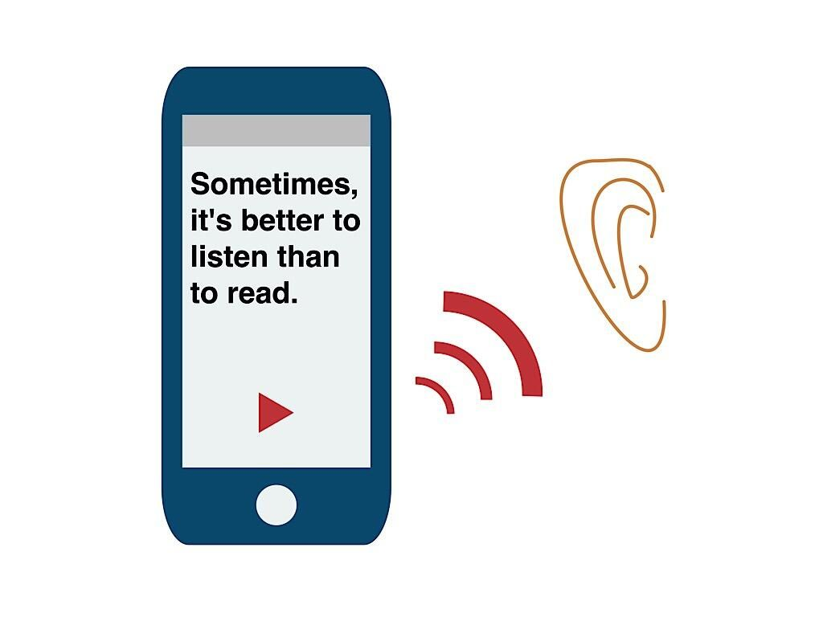

9. Audio descriptions and input
Do you use a screen reader / text-to-speech feature for consuming content?
Female vs male voice
Native vs non-native English speakers
Dialects, accents
Do you use a speech-to-text feature for voice-controlled data entry?
Notes:
What works
What does NOT work
What workarounds do you use to solve problems
What do you prefer instead
Sign language

Slide 17
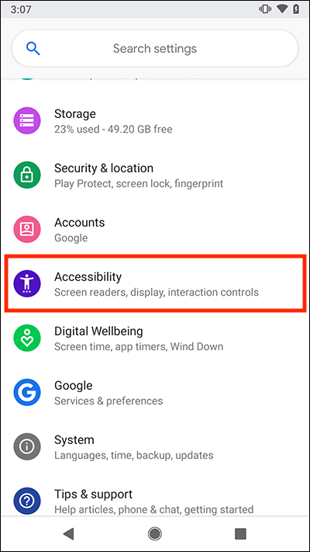
10. Device / app accessibility settings
Do you change accessibility or display settings?
What accessibility settings do you change?
Notes:
What works
What does NOT work
What workarounds do you use to solve problems
What do you prefer instead

Slide 18

Wrap up & Vouchers

Slide 19
Appendix

Slide 20
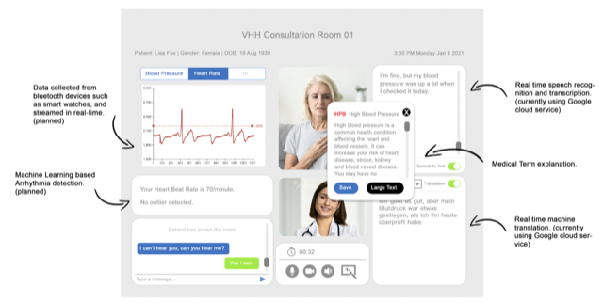
Human-centric e-health applications

Slide 21
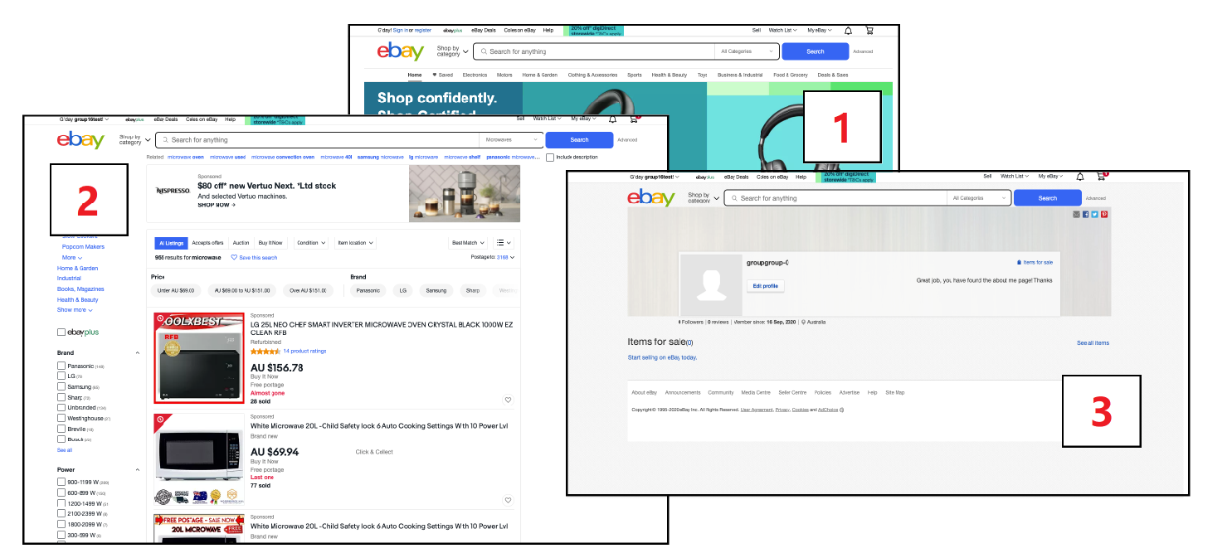
Age bias in e-commerce apps

